Slide 1
Groundwater Overdraft and Management
Kenneth D. Schmidt
Principal
Kenneth D. Schmidt & Associates

Slide 2
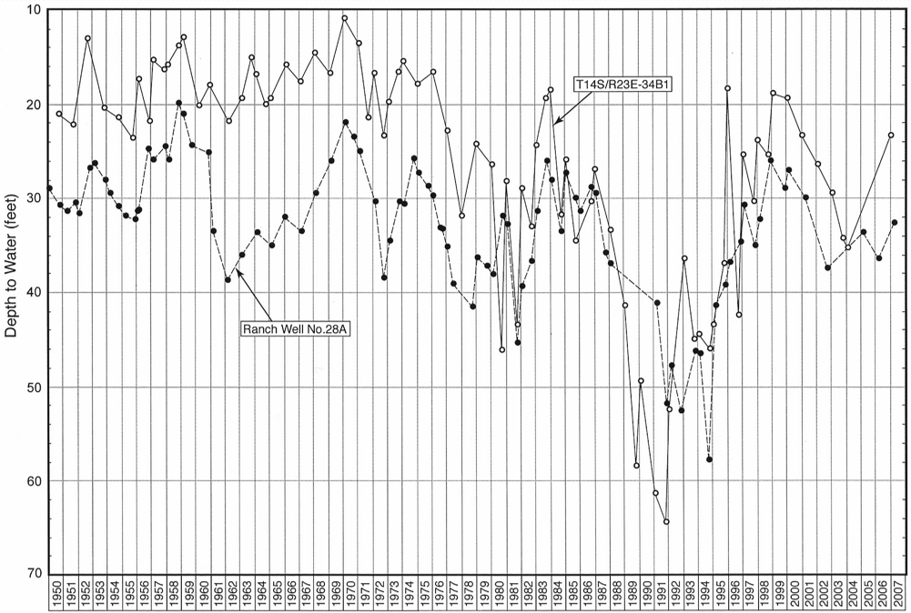
Water-Level Hydrographs for Wells East of Sanger

Slide 3
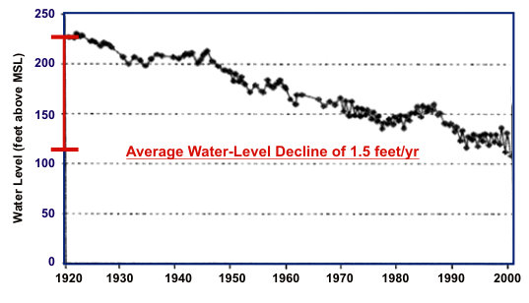
Water-Level Hydrographs for Well Southwest of Madera

Slide 4
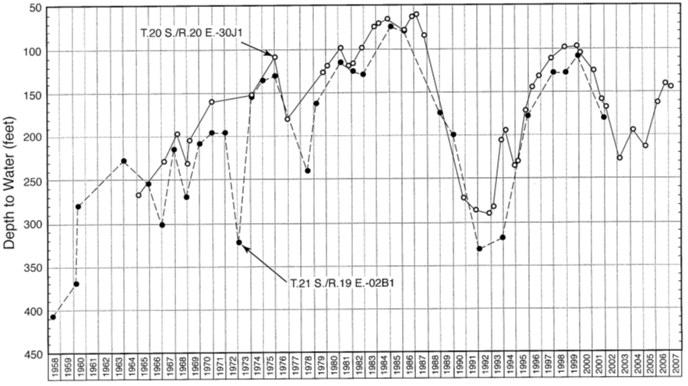
Water-Level Hydrographs for Lower Aquifer Wells in the Lakeside Area

Slide 5
Water Budget for Groundwater
Sources of Inflow Amount (AF/yr)
Streamflow Seepage ______________
Canal Seepage ______________
Deep Percolation from Irrigation ______________
Groundwater Inflow ______________
Intentional Recharge ______________
Subtotal: ______________
Sources of Outflow Amount (AF/yr)
Pumpage ______________
Groundwater Outflow ______________
Subtotal: ______________
Change in Storage: Inflow minus Outflow = ______________

Slide 6
Change in Storage Based on Water Levels
Water-level change (ft/yr) × specific yield (%) × Area = _____ (AF/yr)
Specific yields commonly range from 10 to 20%
For unconfined aquifers only.

Slide 7
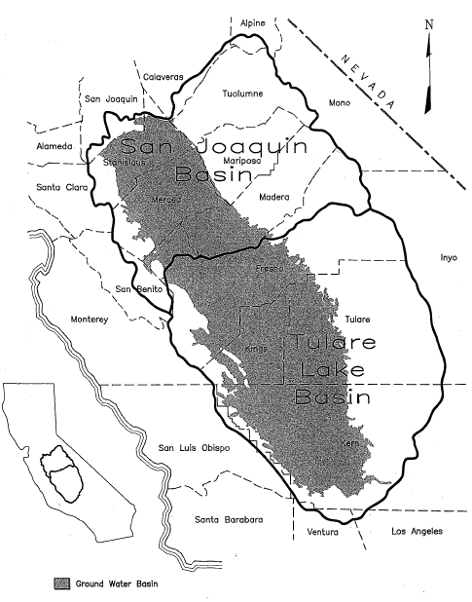
San Joaquin Valley Hydrologic Study Areas
San Joaquin
Basin
Stanislaus
Merced
Fresno
Kings
Tulare
Lake
Basin
Kern

Slide 8
Estimates of Groundwater Overdraft
Early 1970’s Basin 5D 2 million acre-feet per year
Projected 2000 Basin 5D 1.3 million acre-feet per year
2009 (USGS PP 1760) Central Valley 1.3 million acre-feet per year
Present San Joaquin Valley 1.5 to 2.0 million acre-feet per year

Slide 9
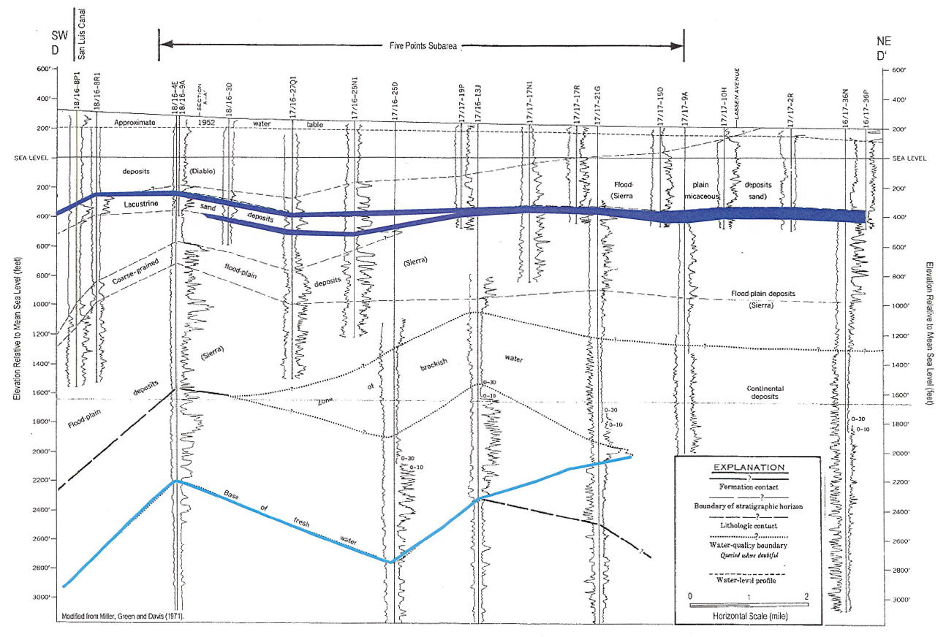
Subsurface Geologic Cross Section Beneath Five Points Subarea

Slide 10
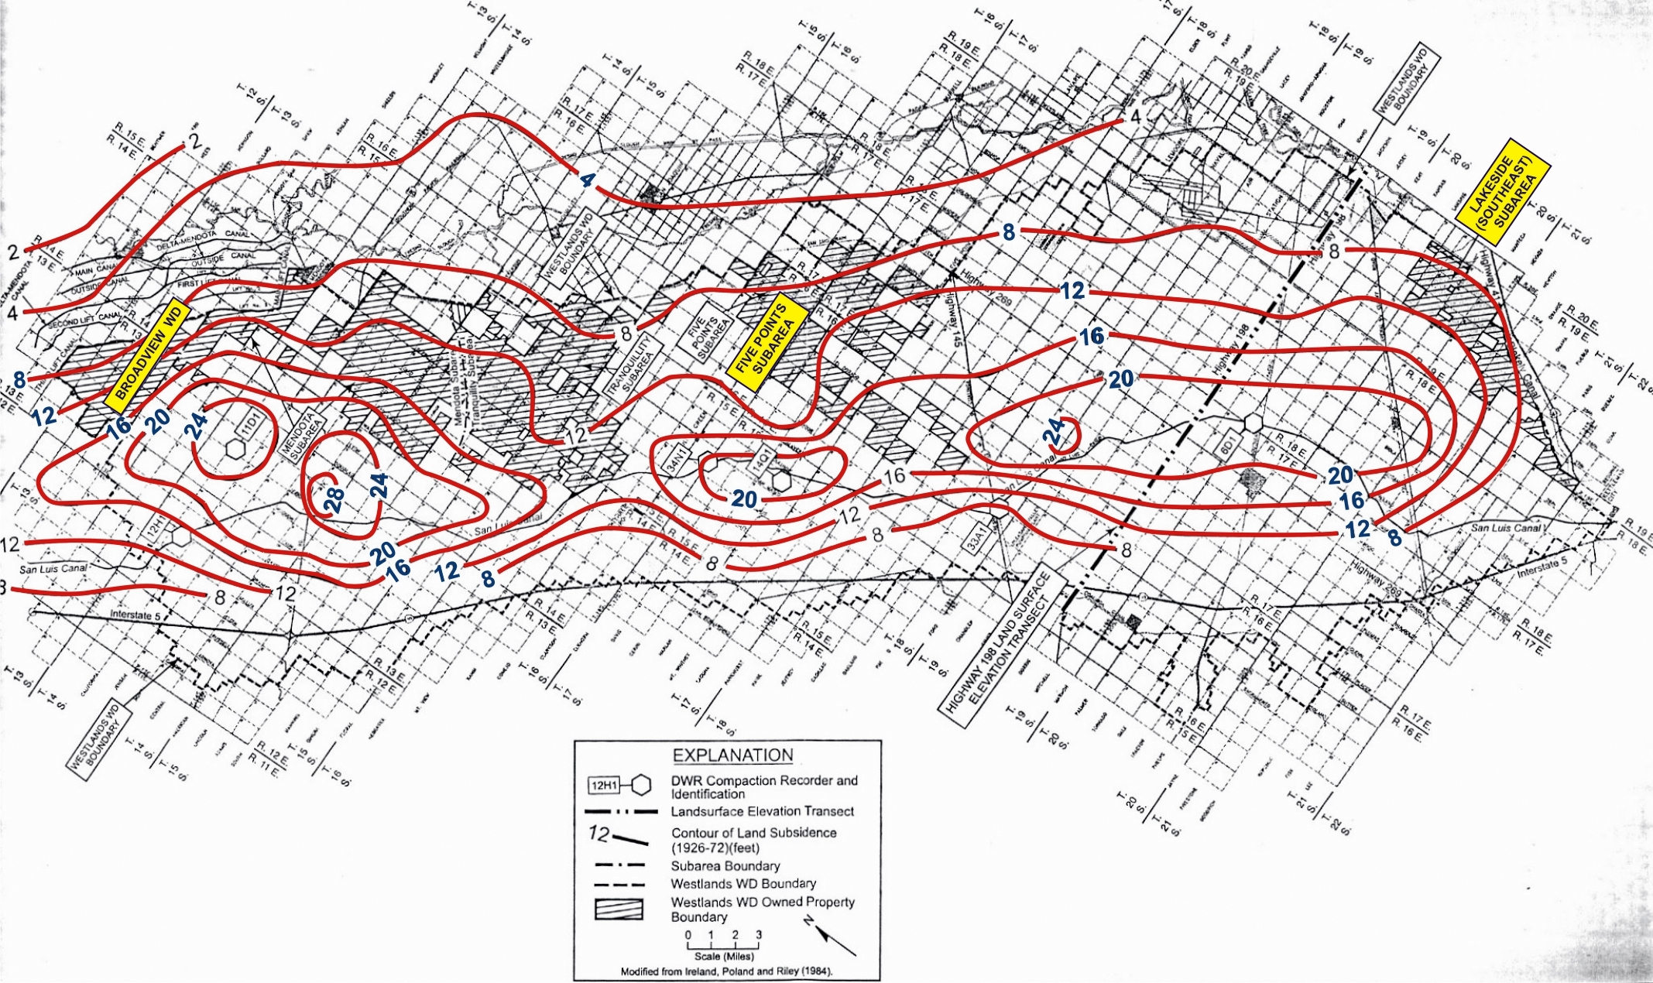
Land Subsidence in the Westlands Water District (1926-1972)

Slide 11
Irrigation Efficiency
Consumptive Use of Applied Water Applied Water
Low Values: 40 to 50%
High Values: 90%
Depends on topsoils and method of irrigation
Commonly:
80 to 90% for drip irrigation
65 to 70% for sprinkler irrigation
40 to 50% for furrow and basin irrigation
= ___ %

Slide 12
Impact of Different Irrigation Efficiencies
Low irrigation efficiencies in areas with surface water supplies resulted in large amounts of recharge of low salinity water, spread out over large areas.
High irrigation efficiencies result in less recharge from irrigation and higher increases in salinity for the shallow groundwater.

Slide 13
Sustainable Groundwater Pumpage
Compare the amount of surface water available to the consumptive use of applied water.
If the surface water is greater than the consumptive use, water levels will rise and there will normally be groundwater outflow.
If the surface water is less than the consumptive use, water levels will fall and groundwater inflow will be enhanced.
If the surface water and consumptive use are equal, groundwater levels will be stable.
The groundwater aquifer should be considered a storage space for surface water, and not a source of water supply itself.

Slide 14
Sustainable Groundwater Pumpage
One interpretation:
If one has no surface water and is not next to a river that is a losing stream, then all of the groundwater pumpage is generally not sustainable.
The only sustainable groundwater pumpage is where there is adequate surface water to balance the consumptive use, unless there is sustainable groundwater inflow to create a balance.

Slide 15
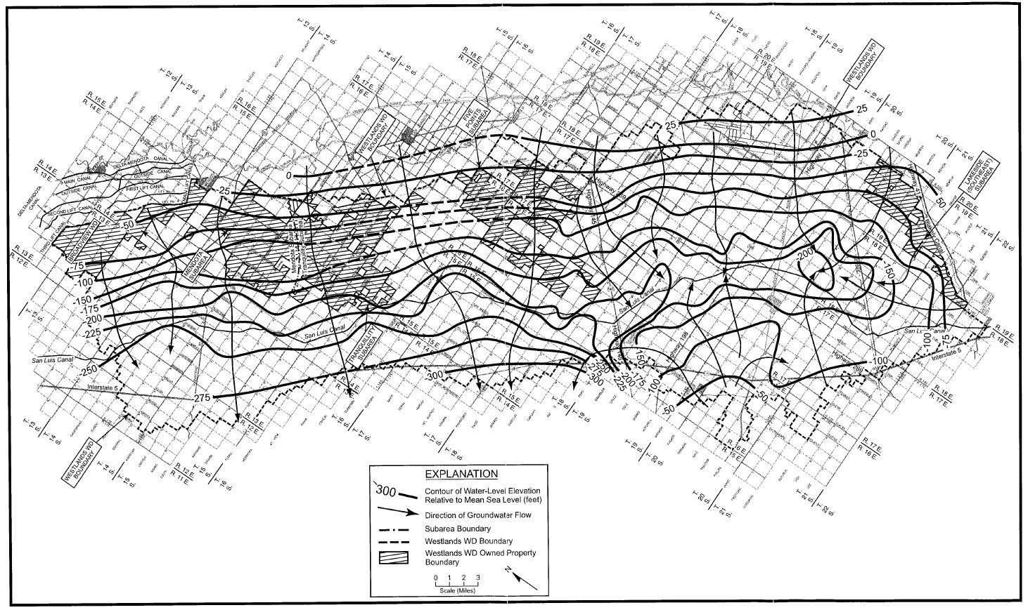
Water-level Elevations in Lower Aquifer Wells in December 1965

Slide 16
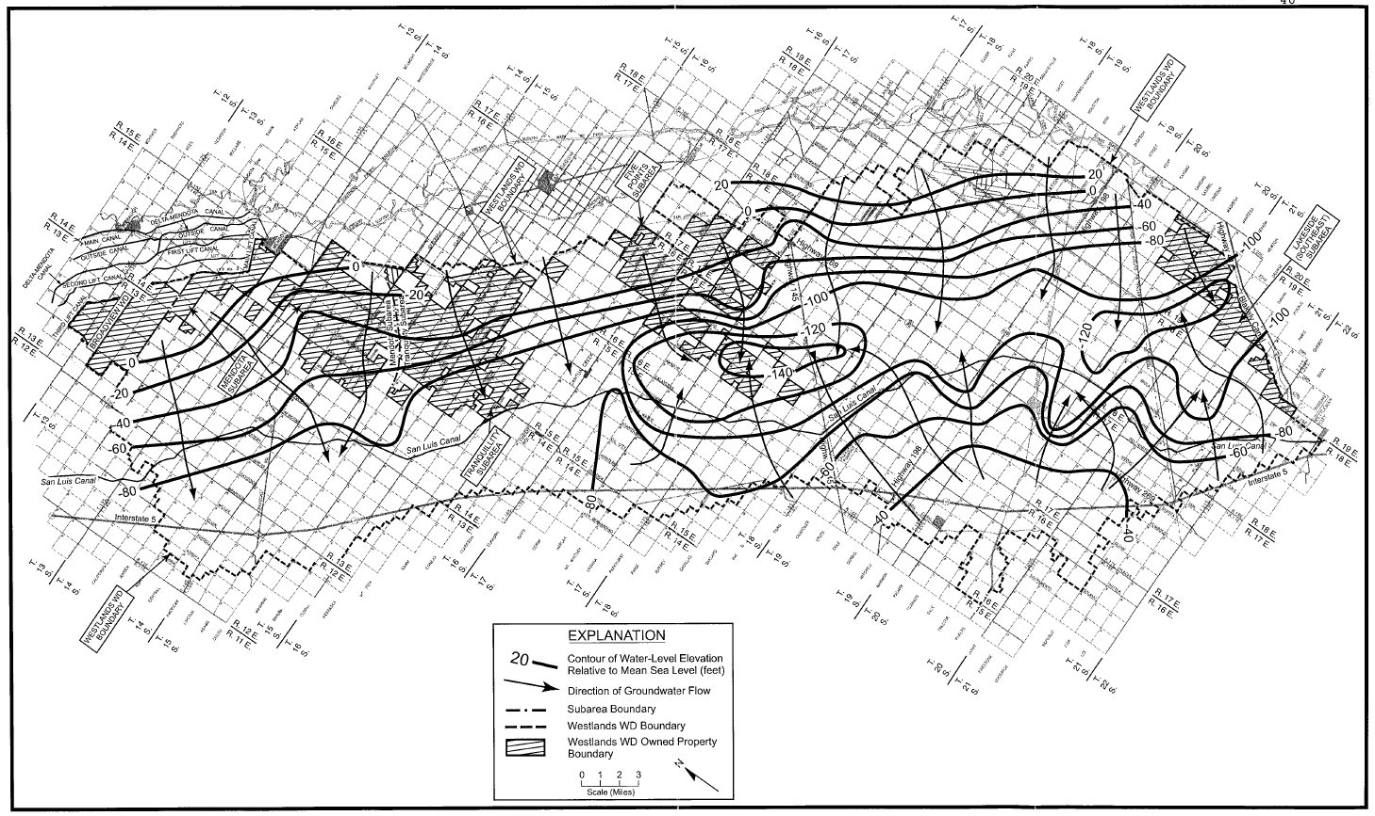
Water-level Elevations in Lower Aquifer Wells in November-December 1993

Slide 17
Determining Groundwater Flow
Use Darcy’s Law: Q = T I L
Q: amount of groundwater flow
T: transmissivity
I: hydraulic gradient
L: width of flow
“I” is determined from shallow and deep zone groundwater maps.
“T” is determined from aquifer tests.
Note: Groundwater modeling is not considered an accurate approach to determine transmissivity.

